Slide 1
Amazon sales analysis 2020-2024
Presented by
NEHA.R

Slide 2
INTRODUCTION
Amazon is one of the largest e-commerce companies in the world.
This project focuses on analyzing an Amazon sales dataset using Power BI.
With the rapid growth of e-commerce, large volumes of data are generated daily, making it difficult to extract meaningful insights.
The dashboard helps understand sales performance, customer behavior, and product trends through interactive visualizations.

Slide 3
PROBLEM STATEMENT
Amazon generates a large volume of sales data every day, making it difficult to identify sales trends, top-performing products, and customer preferences without proper analysis.
The main problem is to convert this raw sales data into meaningful insights using data visualization tools.
This project aims to analyze the data and identify key factors affecting product performance, sales trends, and customer behavior using Power BI

Slide 4
BUSINESS PROBLEM
Which product category has the highest number of products in the dataset?
Which products offer the highest discount percentage?
Which category provides the highest average discount?
Which payment method is used most frequently?
Which country generate the highest total sales?
Which product generate the highest total sales amount?
Which brand generate the highest total sales?
Which order status occurs most frequently?
Which year generate the highest total sales

Slide 5
Data overview
Product name
Category
Price
Discount
Quantity
Total amount
Payment method
Country
Order date

Slide 6
Technology used
Data Source / Collection:
Dataset was collected from Kaggle in CSV format.
Data Cleaning and Preparation:
Handled missing values, removed duplicates, and corrected data types using Power Query.
Data Modeling and Analysis:
Established relationships between tables and structured the data for analysis.
DAX (Data Analysis Expressions):
Used to create calculated measures like total sales, average discount, and KPIs.
Data Visualization:
Created interactive dashboards using charts, slicers, and KPIs in Power BI.

Slide 7
DATA PREPROCESSING
Removed duplicate records
Handled missing values
Corrected data types
Created new columns
Formatted and cleaned data

Slide 8
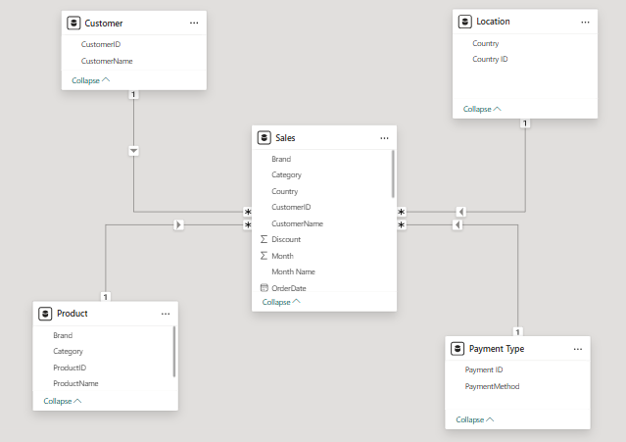
DATA MODELING OVERVIEW

Slide 9
Key performance indicator(kpi)
TOTAL PRODUCTS
TOTAL CATEGORIES
TOTAL ORDERS
AVERAGE PRODUCT PRICE
TOTAL SALES
TOTAL QUANTITY SOLD

Slide 10
DAX MEASURES
TOTAL PRODUCTS = DISTINCT COUNT of product name
TOTAL CATEGORIES = DISTINCT COUNT of category
TOTAL ORDERS = DISTINCT COUNT of order ID
AVERAGE PRODUCT PRICE = AVERAGE of price/ unit price
TOTAL SALES = SUM of total amount/sales
TOTAL QUANTITY SOLD = SUM of quantity

Slide 11
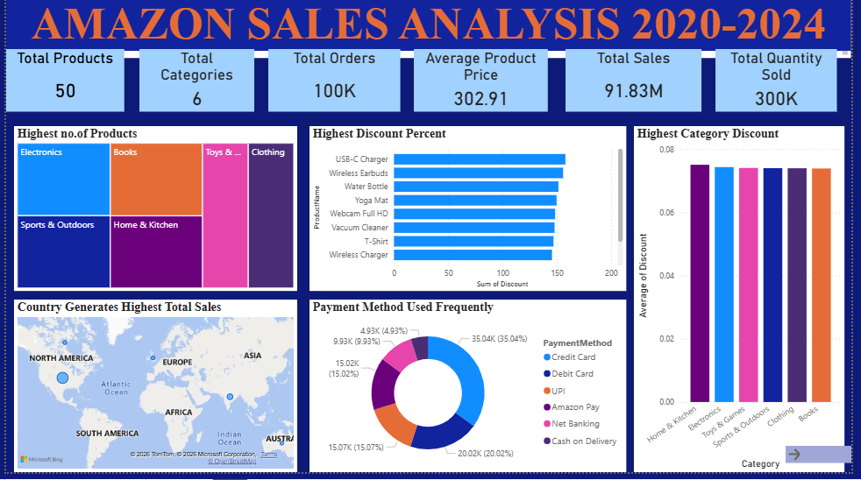
DASHBOARD OVERVIEW

Slide 12
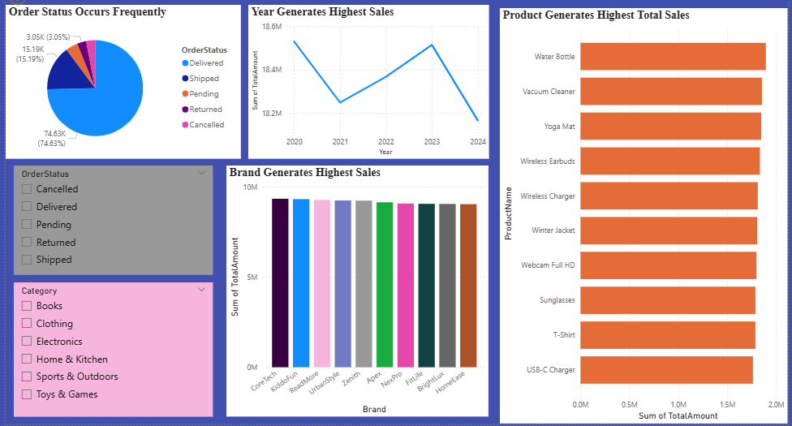

Slide 13
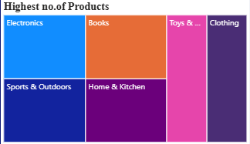
Sales Analysis Charts
Which product category has the highest number of products?
Chart type → Tree map
Group → Category
Values → ProductName
Insights → Shows the category with the most products

Slide 14
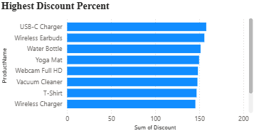
WHICH PRODUCT OFFERS THE HIGHEST DISCOUNT PERECENTAGE?
Chart → Clustered Bar Chart
Y-axis → Product Name
X-axis → Discount
Insights → Identifies products with highest discounts

Slide 15

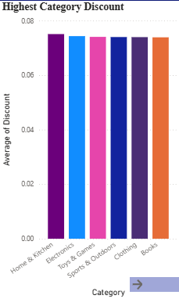
Which category provides the highest average discount?
Chart → Clustered Column Chart
Category → X-axis
Discount → Values
Insights → Shows which category gives more discounts

Slide 16
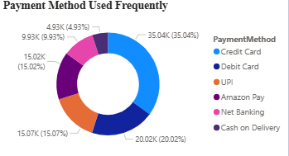
Which payment method is used most frequently?
Chart → Donut Chart
Legend → Payment method
Values → Order ID
Insights → Shows most preferred payment method

Slide 17
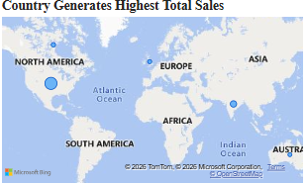
Which country generates the highest total sales?
Chart → Map
Location → Country
Size → Total Amount
Insights → Identifies top sales region

Slide 18
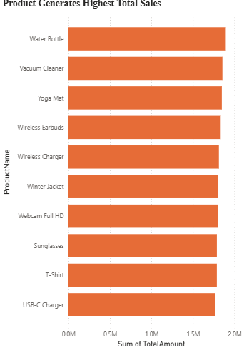
Which product generates the highest total sales?
Chart → Clustered Bar Chart
Y-axis → Product name
X-axis → Total amount
Insights → Shows top-selling product

Slide 19
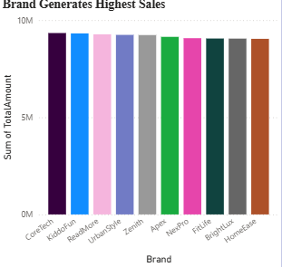
Which brand generates the highest total sales?
Chart → Clustered Column Chart
X-axis → Brand
Values → Total amount
Insights → Identifies top-performing brand

Slide 20
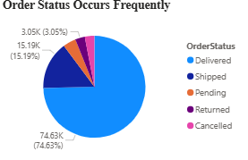
Which order status occurs most frequently?
Chart → Pie Chart
Legend → Order status
Values → Order ID
Insights → Shows most common order status

Slide 21

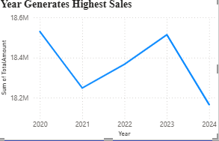
which year generate the highest total sales
Chart → Line Chart
X - axis → Year
Y – axis → Total amount
Insights → Identifies the year with maximum total sales.

Slide 22
CONCLUSION
In conclusion, this project helped us to analyze sales trends and understand business performance over time.
We identified the key factors affecting sales and found the year with the highest growth.
Overall, the insights gained can help in making better business decisions and improving future sales strategies.

Slide 23
THANK YOU

